Slide 1
Why I Am a Christian
Encountering God, Each Other and Ourselves through Jesus Christ

Slide 2
Opening Prayer
Where charity and love prevail,
There God is ever found;
Brought here together by Christ’s love,
By love are we thus bound.

Slide 3
Opening Prayer
With grateful joy and holy fear
God’s charity we learn;
Let us with heart and mind and soul
Now love God in return.

Slide 4
Opening Prayer
Forgive we now each other’s faults
As we our faults confess;
And let us love each other well
In Christian holiness.

Slide 5
Overview of Series
One: Russell and response(s) to Russell
Two: Encountering God through Jesus Christ
Three: Encountering each other through Jesus Christ
Four: Encountering ourselves through Jesus Christ

Slide 6
Overview of Session One
Who is Bertrand Russell?
Russell on religion in general
Russell on Christianity
Small group conversation
Response(s) to Russell
Small group conversation
Homework
Closing prayer

Slide 7
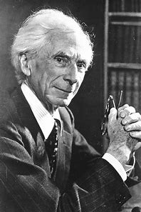
Who is Bertrand Russell?
18 May 1872 – 2 February 1970
Influential intellectual
Born into British aristocracy
An atheist at the age of 18
Pacifist
Married four times

Slide 8
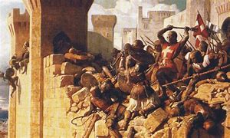
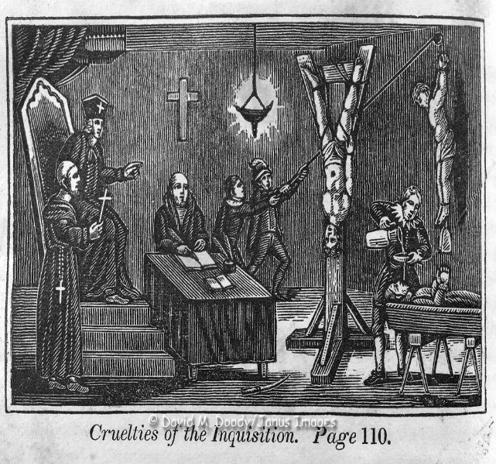
Russell on Religion in General
Untrue and harmful
Result of environmental influences
Harms: (1) kind of belief; (2) particular tenets believed

Slide 9
Russell on Religon in General: Truths and Beliefs
“None of our beliefs are quite true; all have at least a penumbra of vagueness and error. The methods of increasing the degree of truth in our beliefs are well known; they consist in hearing all sides, trying to ascertain all the relevant facts, controlling our own bias by discussion with people who have the opposite bias, and cultivating a readiness to discard any hypothesis which has proved inadequate. These methods are practiced in science, and have built up the body of scientific knowledge….”

Slide 10
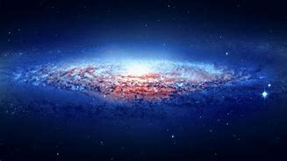
Russell on Christianity: God
First cause argument
Natural-law argument
Argument from design
Moral arguments for Deity
The argument for the Remedying of Injustice

Slide 11
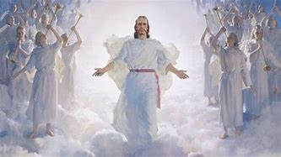
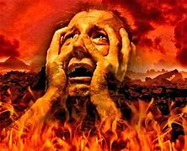
Russell on Christianity: Christ’s character and teaching
Points of agreement
Defects in Christ’s teaching
Belief in imminent second coming
Belief in hell

Slide 12
Russell on Christianity: Emotional Factor
Not argumentation, but emotion
Emotional embrace of religion →cruelty
Fear as the primary source of religious belief
What we must do

Slide 13
Small Group Conversation
What do you agree and/or disagree with in Russell’s positions?
How would you respond?

Slide 14
(My) responses to Russell – Vatican II
Nostra Aetate (Declaration on the Relation of the Church to non-Christian Religions)– 1965
The Catholic Church rejects nothing of what is true and holy in these religions. She has a high regard for the manner of life and conduct, the precepts and doctrines which, although differing in many ways from her own teaching, nevertheless often reflect a ray of that truth which enlightens all men….” (art. 2)

Slide 15
(My) Responses to Russell: Healthy, Holy Fear and Grateful Joy
Healthy, holy fear
Grateful joy
Creatureliness
Limitation
Contingency
Dependence
Undeserved, unexpected, transformative experience of being loved
Sense of awesome beauty and goodness

Slide 16
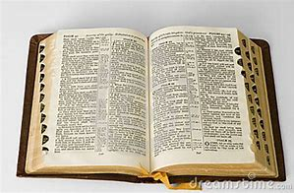
Naïve Reading of Scripture (and Tradition?)
Apparent absence of accepted contemporary principles of interpretation
Focus on Jesus’ teaching, but not other ministerial activity
Limited sample size

Slide 17
Russell’s Understanding of Relevant Evidence
Scientific, empirical, objective
Seems to rule out “reported” experience, subjective “experience”
Consequences:
Differences in belief → All not true
Rules out “healthy, holy fear” and “grateful joy”
Excludes much Christian witness/testimony

Slide 18
Alternative Approaches to Russell: Christianity “works”
“a pragmatist interpretation, following a line of thinking that goes back to William James, the nineteenth-century philosophy of mind. To judge the truth of something, James argued, you don’t need to trace it all the way back to its ultimate nature – what philosophers call its ontology. That may be inaccessible to you and not directly relevant, anyway. What is important is what works….”

Slide 19
Alternative Approaches to Russell
Engaging Jesus as a symbol through which to encounter God, each other and ourselves
Engagement is fundamental and primary
Interpretation of the engagement follows
Assessing the truth follows the interpretation
Russell seems to focus on the truth to the neglect of the engagement and the complexities of interpretation

Slide 20
Small Group Conversation
What do you agree or disagree with in my responses?
What would you change or add?

Slide 21
Homework
Superbowl commercial, “Footwashing” exercise

Slide 22
Closing Prayer
Let strife among us be unknown,
Let all contention cease;
Be God’s the glory that we seek,
Be ours God’s holy peace.

Slide 23
Closing Prayer
Let us recall that in our midst
Dwells God’s begotten Son;
As members of his body joined,
We are in Christ made one.

Slide 24
Closing Prayer
No race nor creed can love exclude,
If honored be God’s name;
Our family embraces all
Whose Father is the same.

